Slide 1
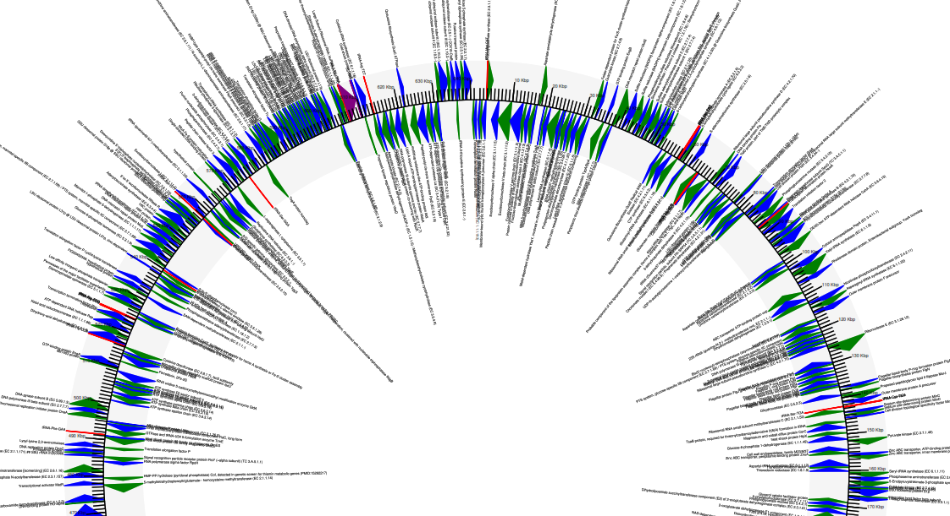
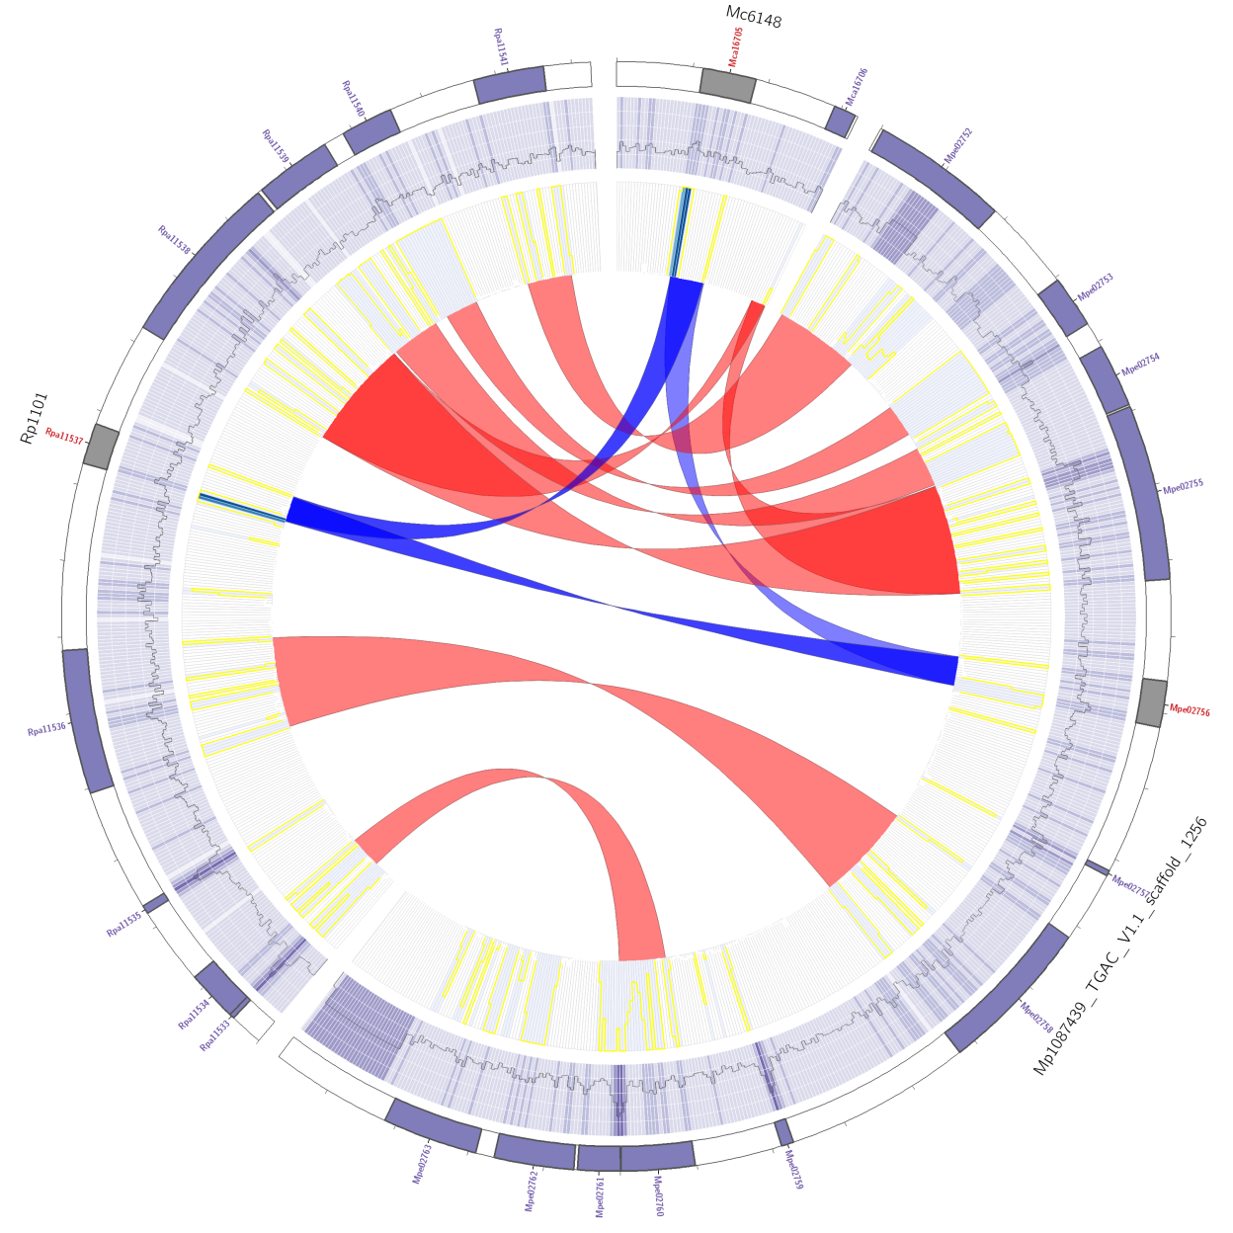
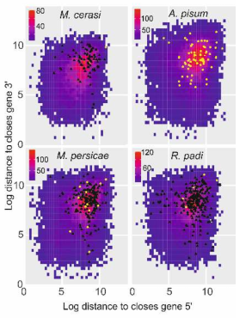
Data analysis on the cluster
NGS and third generation sequence analysis

Slide 2

Hand outs?
Please think twice about printing. (you cant copy and paste from paper)
Save the planet/ kill the planet less fast
We will be downloading this presentation very soon .. ☺

Slide 3
Overview
Cluster overview
Getting connected
Basic Unix
Shell scripting (editing, running)
qsub: Sun Grid Engine (monitoring status, submitting scripts)
Assembly example
Conda
Downloading and compression
Advanced section
THINGS IN THIS COLOUR ARE COMMANDS
ACTIVITY
This is where you play on the computer!

Slide 4
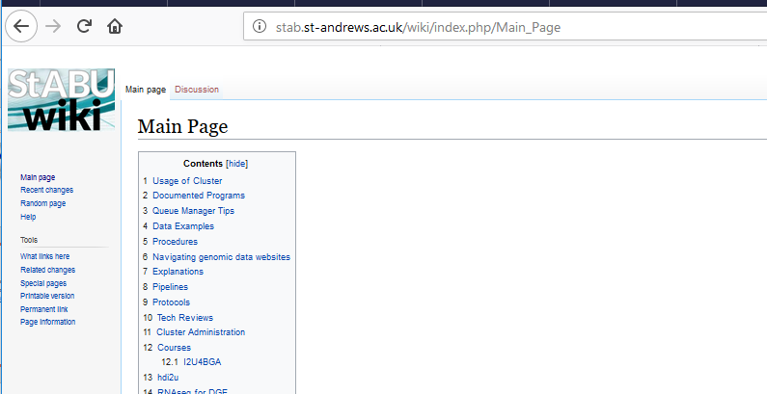
1) Cluster overview: Documentation
ACTIVITY
Obviously the documentation for the tool you are using (tool –h)
Bioinformatics unit wiki - loads of useful Marvin stuff here
http://stab.st-andrews.ac.uk/wiki/index.php/Main_Page

Slide 5

1) Cluster overview: Getting help
There is going to be too much in here for you to remember. So you can:
Look back at this presentation
Website: http://stab.st-andrews.ac.uk/wiki/index.php/Main_Page
Google is amazing! - I have to look up stuff ALL the time

Slide 6
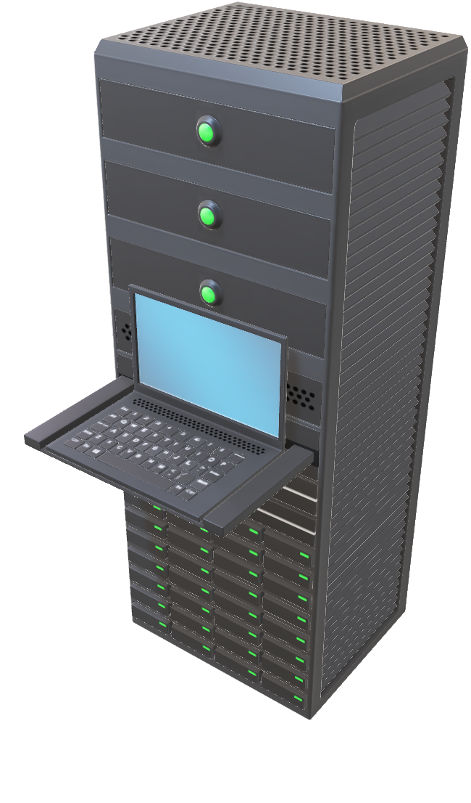
1) Cluster overview: Why use the cluster?
High grade CPUs – error correction for long jobs
Access to 500GB of RAM on a single machine (node).
Access to terabytes of enterprise classstorage for large datasets.
Jobs run over many cores, run much faster than a desktop.
Operating system: Linux.
This will run lots of free software.
Most of which only work on Linux

Slide 7
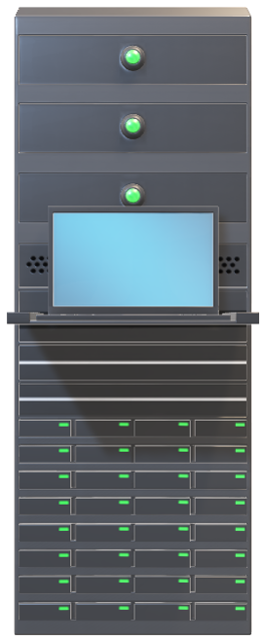

Cluster overview: Marvin
13 nodes: 368 threads 3.3 TB RAM
4 nodes have 500GB of RAM.
96 TB storage, backed up nightly.
250 software packages available
through moduleload
Conda: >10,000 packages!!
Singularity for Docker images.
HOSTNAME | Threads | Memory
marvin | 32 | 504.8G
Phylo | 80 | 500G
Slayer | 48 | 256G
Beast | 48 | 256G
node1 | 16 | 126.0G
node10 | 16 | 252.3G
node2 | 16 | 110.2G
node3 | 16 | 500G *
node4 | 16 | 2560G
node5 | 16 | 126.0G
node6 | 16 | 126.0G
node7 | 16 | 126.0G
node8 | 16 | 126.0G
node9 | 16 | 504.7G
TOTAL | 368 | 3.370TB

Slide 8
2) Getting connected
Open this power point (you wont be able to yet!). Learn how to connect to Marvin (2_Getting_connected.pptx)

Slide 9
3) Basic UNIX: open the PowerPoint
Short practical, basic UNIX commands (3_basic_UNIX.pptx)
Joe Ward has written an extended tutorial for you all, which you will download shortly called: unixCourse_latest.zip. This is for you to do in your own time, or here if you are fast.

Slide 10
4) Shell scripting: open the PowerPoint
Here we learn how to “talk to the computer” (4_Shell_scripting.pptx)

Slide 11
5) qsub: submitting jobs to the server.
Now we have learnt how to write shell scripts, we can now submit jobs to the cluster via qsub
Open 5_qsub.pptx

Slide 12
Moving on to an actual example
I know there was a lot of background … but…
Now we know how to write shell script.
Lets do a bacterial genomes assembly as an example
We have already looked at fastqc to qc our read files.
Open 6_assembly.pptx

Slide 13
5) qsub: qsub output files .o and .e files
Now we have run several job. Have a look at the .o and .e files.
.o files have normal output from whatever tool is being used.
.e are errors or warnings. This is useful to track errors and find out why your tool is not working.

Slide 14
8) Downloading and decompressing
wget web-link_to_data
Decompress. Depends on the type of compression. Google is your friend.
unzip folder.zip
tar -zxvf folder.tar.gz
gunzip file.gz
pigz -d file.gz

Slide 15
8) compressing: Storage is very limited
Good management of data is essential. You must clean up your temp files. Compress all data. No sam or bam files should be kept on the cluster. These can be recreated.
You must compress your files
pigz filename or gzip filename
Or a * wildcard for all fastq files
pigz -p 4 *.fastq (use 4 cores)
Please do not keep .sam files. Convert these to bam files. They are easily regenerated!

Slide 16
8) decompressing
Some tool cannot work with compressed files. Usually DNA mapping tools
To decompress file:
pigz -d filename or gunzip filename
To unzip a zipped folder:
unzip folder_name.zip
To unzip a tarball:
tar -zxvf
Google the rest ……

Slide 17
8) Downloading: scp - transfer files
scp <filename> <username>@marvin.st-andrews.ac.uk:~
To copy an entire directory, you need to add the -r to the scp command above-
Copy something FROM marvin TO your machine. For this, the reverse
enter marvin and type:
scp -rp <directoryname> <username_on_your_computer>@<IP_number_of_your_computer>:/</desired/path_on_your_computer>

Slide 18
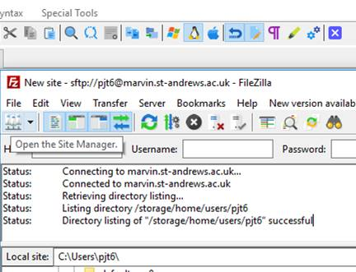
8) Downloading: transfer files Filezilla https://filezilla-project.org/download.php
Step 1. Open host

Slide 19
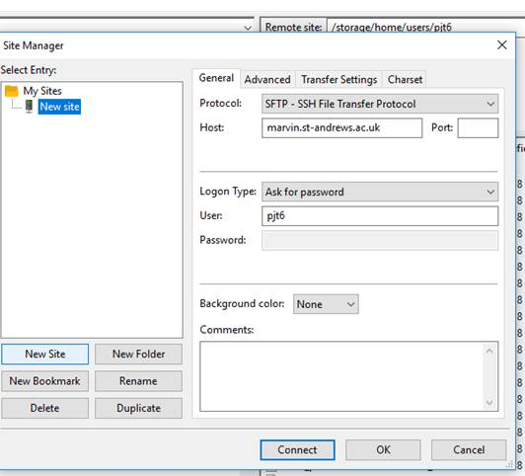
8) Downloading: transfer files Filezilla
2) When the next dialogue page comes up, click on “new site” (button , not the folder). Change the Protocol to SFTP. This is essential. Fill out the rest, use this host and port: 22.
Once connected, you can drag and drop files from one window to the next.
sfpt

Slide 20
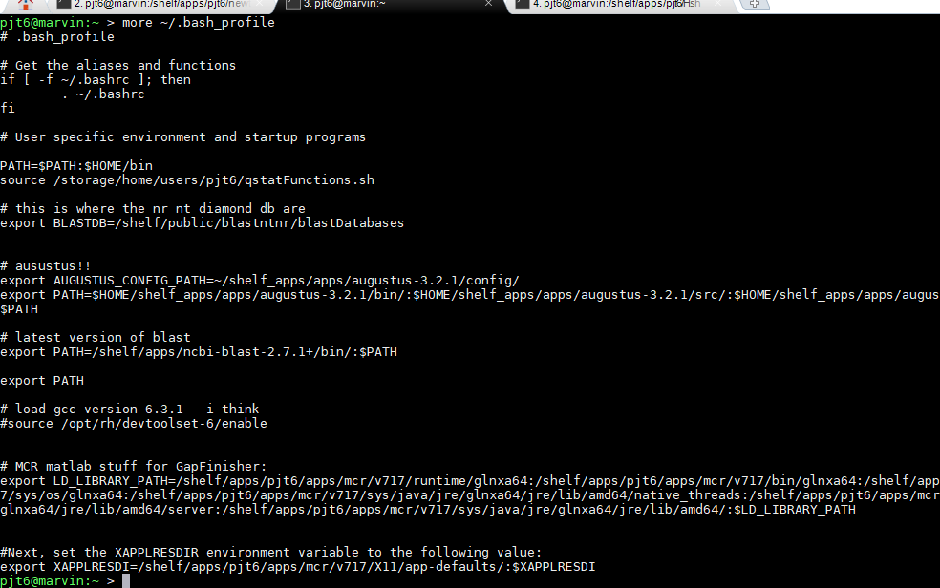
9) Advanced: .bash_profile
ACTIVITY
This is beyond a beginners course, but just to make you aware of it…
Type: more ~/.bash_profile
This is where you can tell the server to
“look for programs”, set environmental
variables, and other magic!!
I put the latest BLAST in, with db:
export PATH=/shelf/apps/ncbi-blast-2.7.1+/bin/:$PATH
# this is where the nr, nt, diamond db are
export BLASTDB=/shelf/public/blastntnr/blastDatabases

Slide 21
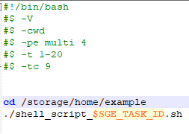
9) Advanced: Task array
If you have many jobs to run on the cluster, you can run them as an array
This is SGC_TASK_ID 1-20
you would have shell_script_1.sh
up to 20 in your directory
Max number of jobs to run at once

Slide 22
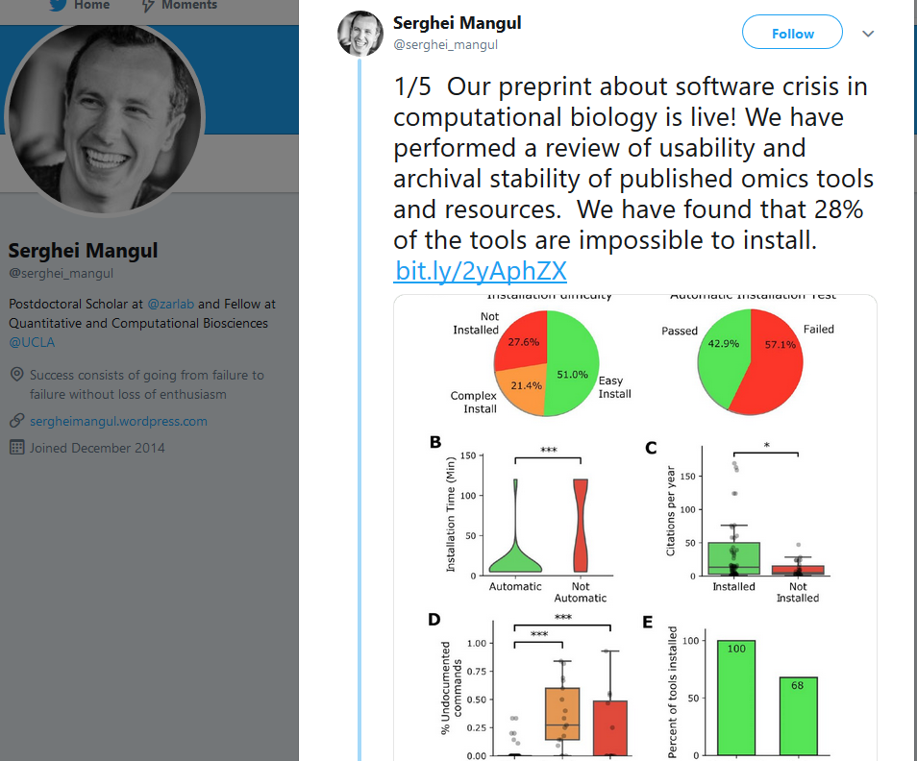
9) Advanced: Installing software:
Please try yourself. This is good for you.
Try conda first (see earlier slides).
If not on conda: read their README
and follow their instructions.. But …
If you need a newer GCC:
Type:
source /opt/rh/devtoolset-6/enable
gcc -v
gcc version 6.3.1 (GCC)

Slide 23
9) Advanced: Installing software:
Manual method; this is different from tool to tool. But as an example:
Download:
wget weblink
Decompress:
tar -zxvf tool.tar.gz
cd into the folder (read the readme)
Configure:
./configure CXX=/usr/local/Modules/modulefiles/tools/gcc/4.9.3/bin/g++ CPP='/usr/local/Modules/modulefiles/tools/gcc/4.9.3/bin/g++ -E' --prefix=/somewhere/
make
make install
The above (g++) is a historical way the server was set up - sorry. This cannot be changed, unless we get the new server.

Slide 24
9) Advanced: Installing software
ACTIVITY
In fact we have installed software. Trimmomatic. We ran this by giving the path to the executable file (binary).
We installed via conda. Activated the env which the tool was in …
We loaded a modules using module load.
That is three different ways of running software.
A fourth: git clone. Go to this page. https://github.com/kakitone/finishingTool
git clone https://github.com/kakitone/finishingTool.git - done!

Slide 25
9) Advanced: Singularity/ Docker
ACTIVITY
Some software is published as Docker images which (may/ should) contain all the dependencies you need and should just work:
http://stab.st-andrews.ac.uk/wiki/index.php/Singularity_with_grid_engine
Go to https://hub.docker.com/ and search a tool or even an operating system. E.g. pytorch
The resulting .sif file is your image.
qrsh -l hostname=phylo -q centos7.q
singularity run pytorch_latest.sif
singularity pull docker:pytorch/pytorch

Slide 26
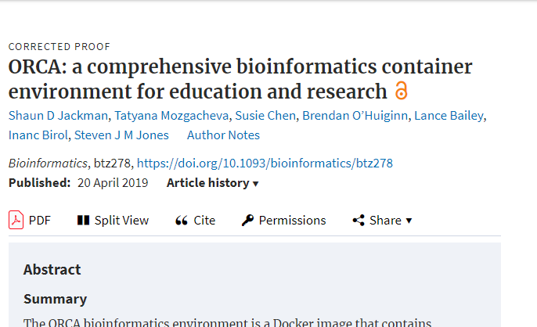
9) Advanced: Singularity/ Docker
ACTIVITY
https://hub.docker.com/r/bcgsc/orca/
singularity pull docker:bcgsc/orca
This has 626 software packages in it!!!
https://github.com/bcgsc/orca/blob/master/versions.tsv

Slide 27
9) Advanced: snakemake
Snakemake is a way of making data analysis reproducible.
There is one example with this course, which is an assembly we have already done. More:
https://hpc-carpentry.github.io/hpc-python/11-snakemake-intro/
https://blog.liang2.tw/2017Talk-Snakemake/
conda install -c bioconda snakemake

Slide 28
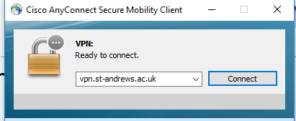
Connecting off site
Use the University VPN connection.
It will ask you for your user name and password. Then you can work as if you are on site.
Students may need to request access from central IT

Slide 29
Wrap up: Data management
Storage is always an issue - everywhere you go! - Except here it is worse! ☹
You will get a lot of data - I understand this. I may pester you to reduce your usage … How, you ask?
Compress files, Always keep your raw data and your scripts!!!
keep your shell scripts in logical places, well labelled and documented on what they do. (you will thank me when writing up the papers)
you don’t always (rarely!!) need to keep intermediate files, especially if they can be easily regenerated.

Slide 30
Wrap up: Data management
Keep your raw data in a folder called (example):
20181113_RNAseq_species_experiment
20181113_RNAseq_aphids_host_nonhost
That is year/month/day, what the data is, species, experiment.
Keep your scripts in this master raw folder (in a new folder), so it can be reproduced, or taken over by anyone who continues the project after you.

Slide 31
Wrap up: cluster etiquette
shh directly into nodes will not be tolerated .. No punishment specified yet. Lets not get to that point.
Please do not run multi-core jobs directly on the Marvin command line. Single core jobs which take less than 20 mins is ok.
Jobs running on Marvin via the qsub system in ok.

Slide 32
Wrap up: how is the cluster funded
Each PI pays either £500 or £1500 per year, per funded project.
Grants should cost in StABU staff time: 5%, 10% sys admin help and light data analysis, 20% data analysis … Or other….
Basically, we are grant funded. We are researchers and are judged on papers and £££. So, if we significantly help you please consider authorship.

Slide 33

The end
Remember all bioinformatics is, it repeatedly pressing the red button and everything just happens

Slide 34
SNP calling example
If we get to this bit. Well done. You were fast!
Ok, so open ./shell_scripts/basic_SNP_calling.sh
This has the basic workflow to call and characterise the effects of SNPs.
Be careful, this will not work directly on your data… (ploidy, SNPeff database…)
Read up on the tools and adjust as required.

Slide 35
Appendix: E. coli reads - how I prepared the data
wget ftp://ftp.sra.ebi.ac.uk/vol1/fastq/DRR021/DRR021340/DRR021340_1.fastq.gzwget ftp://ftp.sra.ebi.ac.uk/vol1/fastq/DRR021/DRR021340/DRR021340_2.fastq.gzpigz -d *.gzconda activate python27 python Filter_fastq_for_every_nth_sequence.py -i DRR021340_1.fastq -n 50 -o subsampled_R1.fastqpython Filter_fastq_for_every_nth_sequence.py -i DRR021340_2.fastq -n 50 -o subsampled_R2.fastq
python ../scripts/Filter_fastq_for_every_nth_sequence.py -i illumina_R1.fq -n 5 -o subsampled_R1.fastqpython ../scripts/Filter_fastq_for_every_nth_sequence.py -i illumina_R2.fq -n 5 -o subsampled_R2.fastq
pigz *

Slide 36
Vim - command line editor
Command line editing is horrible. Sorry!
Type
vim name_of_file
Press the i key to insert. Now you can delete, type or whatever.
To save: ESC (Key), : then wq

